Slide 1
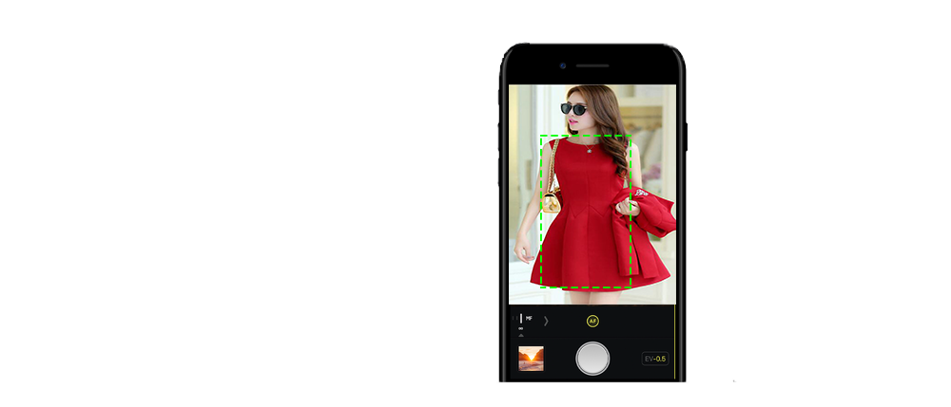
Match-It
The next generation fashion assistant

Slide 2

Mission statement: We wanted to match it for you.

Slide 3
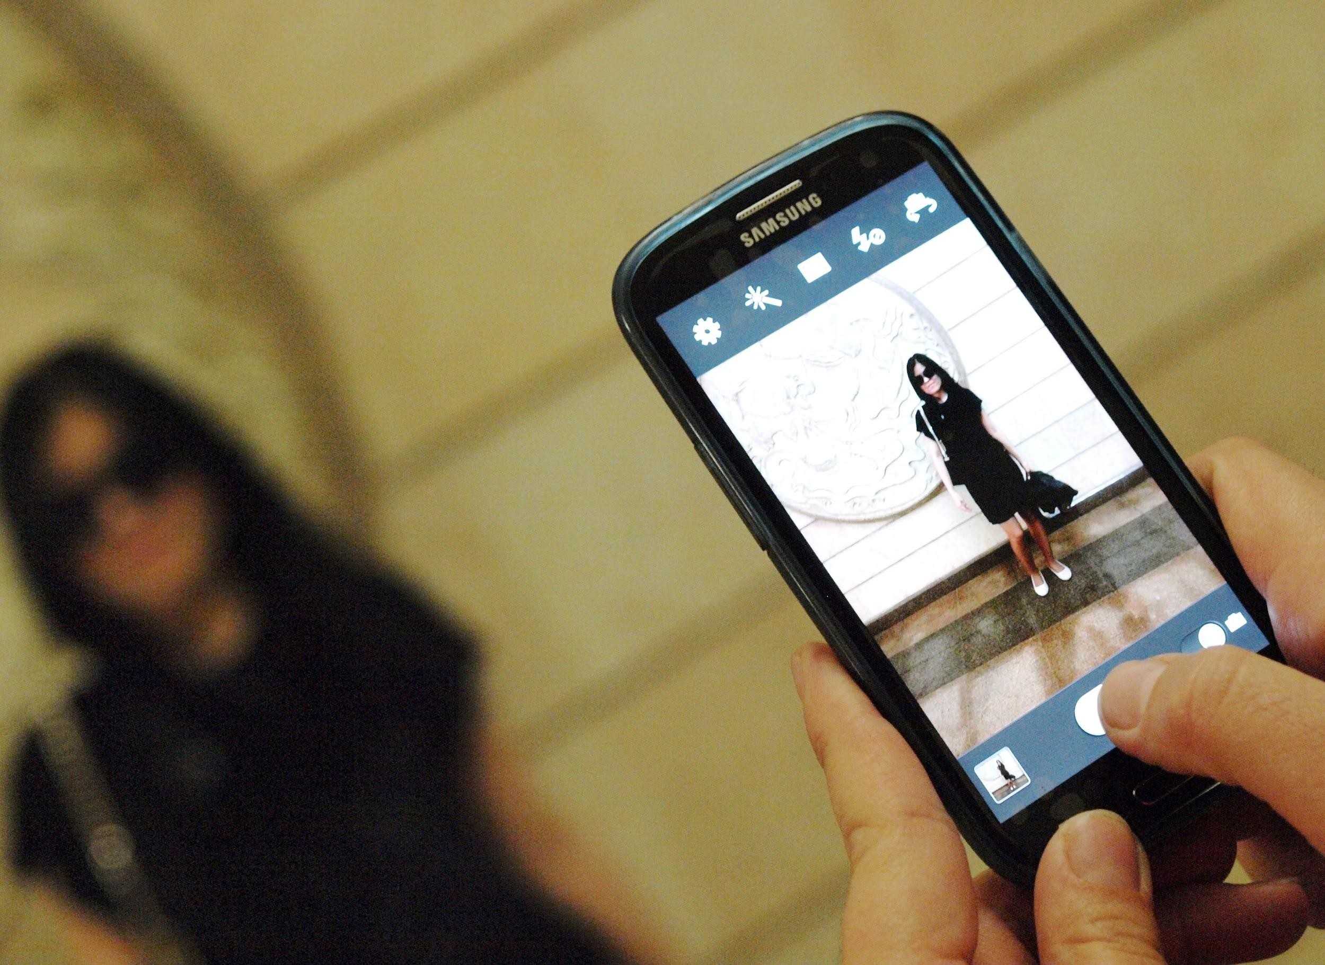
The solution|
It’s a mobile application.
What will be different when the problem is solved (by you)?

Slide 4
How it works
Step 3
Step 2
Step 1
Find it,
Match it,
Click it,
Take a picture
Find the best match for you
Compare & identify

Slide 5
The market value
Advertising platform
Products statics
Automation in fashion
A product with a good business value.
20XX | 20XX | 20XX | 20XX

Slide 6

The technology:
CLOUD + IMAGE RECOGNITION

Slide 7
Platform
Architecture
Cloud
Database
The currently implemented system works through RESTFul API Communications.

Slide 8

Future Implementations
Cross Platform Implementations
Develop an API for market holders
Social Platform for Fashion Enthusiast
Advancing technologies with Neural networks

Slide 9
Milestones
This shows where are we in the process and what’s left to tackle
CloudHack 17
December 2017
April 2018
September 2017
January 2018
Extends with web based services
The day Match-It kept its first commit
Develop an API for market holders
Advancing technologies with Neural networks
Aug12 | Aug13 | Sep | Oct | Nov | Dec | Jan | Feb | Mar | Apr | Jun | Jul
Extends user with cross platform implementations
Social Platform for Fashion Enthusiast

Slide 10
Thank you

